Slide 1
Chapter 5 Introducing the Internet

Slide 2
What is the Internet?
The Internet is a worldwide collection of networks that link together millions of businesses, governments, educational institutions, and individuals.
Each of these networks provides resources and data that add to the abundance of goods, services, and information accessible via the Internet.

Slide 3
Evolution of the Internet
Topics Covered:
From ARPANET to Internet2
The World Wide Web
Internet2
The Internet Community Today

Slide 4
A Brief History of the Internet
The Pentagon’s Advanced Research Projects Agency (ARPA) begins a project to network computers around the country, ARPNET.
1969 The first computers are connected to the ARPNET
1972 The first e-mail is sent
1981 the IBM PC is introduced
1984 Apple introduces the McIntosh computer

Slide 5
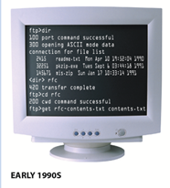

A Brief History of the Internet
In 1989, a researcher named Tim Berners-Lee proposed the idea of the World Wide Web (WWW) as a way to organize information in the form of pages linked together through selectable text or images (today’s hyperlinks) on the screen.

Slide 6
A Brief History of the Internet
1992 Windows 3.1 is introduced
1993 a graphic interface for the WWW is created called Mosaic. This will become Netscape Navigator.

Slide 7
How the Internet Works – Services Provided
E-mail
File Transfer Protocol
World Wide Web
Streaming media
Chat rooms and message boards.
These services are called protocols in the computer world.
A protocol is a standard procedure for regulating data transmission between computers

Slide 8
How the Internet Works – Services Provided
WWW
E-mail
Streaming Media
FTP

Slide 9
The World Wide Web
The World Wide Web, or simply Web, consists of a worldwide collection of electronic documents, Web pages, organized into Web sites.
A growing number of today’s Web-based applications and services are referred to as Web 2.0 applications.
Web 2.0 uses the Web as a platform to deliver rich applications that enable people to collaborate, socialize, and share information online, including;
cloud computing
social networking sites
Podcasts
Blogs
Wikis.

Slide 10
Internet2
Internet2 is a consortium of researchers, educators, and technology leaders from industry, government, and the international community that is dedicated to the development of revolutionary Internet technologies.
Internet2 uses high-performance networks linking over 200 member institutions to deploy and test new network applications and capabilities.

Slide 11
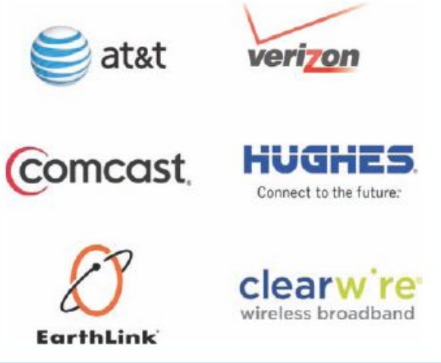
Members of The Internet Community Today
Users - People who use the Internet to retrieve content or perform online activities,
Internet service providers (ISPs) - Businesses or other organizations, including telephone, cable, and satellite companies, that provide Internet access to others,

Slide 12
Members of The Internet Community Today
Internet content providers - are imposed on what information is published on Web servers located in China, as well as on the in-formation
Application service providers (ASPs) - companies that manage and distribute Web- based software services to customers over the Internet.
Infrastructure companies - The enterprises that own or operate the paths or “ roadways” along which Internet data travels, such as the Internet backbone and the communications networks connected to it.
Hardware and software companies - The organizations that make and distribute the products used with the Internet and Internet activities.

Slide 13
Members of The Internet Community Today
Governments - The ruling bodies of countries that can pass laws limiting both the information made available via Web servers located in a particular country and the access individuals residing in that country have to the Internet.
Key Internet organizations - Other organizations that are responsible for many aspects of the Internet including;
Internet Society (ISOC)
ICANN ( Internet Corporation for Assigned Names and Numbers)
The World Wide Web Consortium ( W3C) is a group of over 450 organizations dedicated to developing new protocols and specifications to promote the evolution of the Web and to ensure its interoperability.

Slide 14
Beyond Browsing and Email
Topics Covered:
Other Types of Online Communications
Blogs, Wikis, and Other Types of Online Writing
Cookies

Slide 15
Other Types of Online Communications
Instant messaging (IM) allows you to exchange real- time typed messages with people on your buddy list— a list of individuals such as family, friends, and business associates whom you specify.
Text messaging is a form of messaging frequently used by mobile phone users.
Tweeting, sometimes referred to as microblogging, is a free service that allows members to post short updates—called tweets—about what they are doing at any moment.

Slide 16

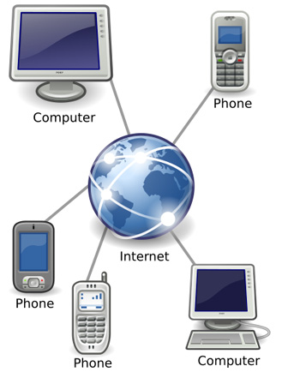
Other Types of Online Communications
Today, the standard term for placing telephone calls over the Internet or any other type of data network is Voice over Internet Protocol (VoIP) and it can take many forms.
Web conferences typically take place via a personal computer or mobile phone and are used by businesses and individuals.

Slide 17
Other Types of Online Communications
Webinars (Web seminars) are similar to Web conferences, but typically have a designated presenter and an audience.
A social networking site can be loosely defined as any site that creates a community of individuals who can communicate with and/or share information with one another.

Slide 18
Blogs, Wikis, and Other Types of Online Writing
A blog—also called a Web log—is a Web page that contains short, frequently updated entries in chronological order, typically as a means of expression or communication.
Wikis, named for the Hawaiian phrase wiki wiki meaning quick, are a way of creating and editing collaborative Web pages quickly and easily.

Slide 19
E-commerce
Financial transactions online including;
Selling goods and services
Banking
Buying and selling stocks.

Slide 20
Cookies
Many Web pages today use cookies—small text files that are stored on your hard drive by a Web server—to identify return visitors and their preferences.
Third-party cookies are cookies placed on your hard drive by a company other than the one associated with the Web page that you are viewing—typically a Web advertising company.

Slide 21
Getting Set Up to Use the Internet
Topics Covered:
Selecting the Type of Device
Choosing the Type of Connection and Internet Access
Selecting an ISP
Setting Up Your Computer

Slide 22
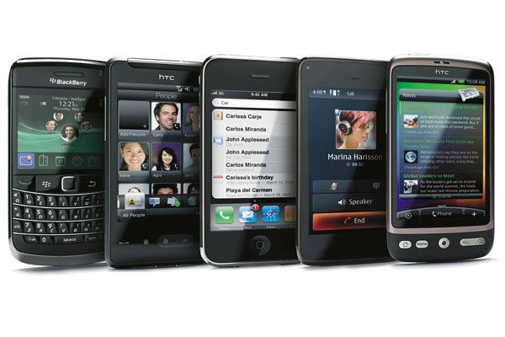
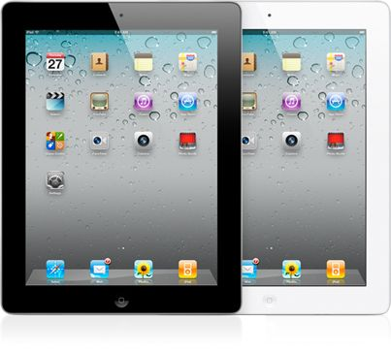
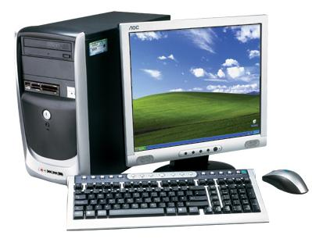
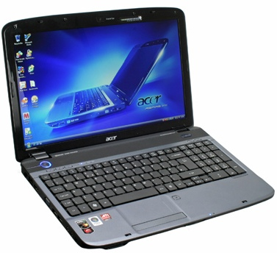
Selecting the Type of Device
The Internet can be accessed using a variety of devices.

Slide 23
Choosing the Type of Connection and Internet Access
Most common typed of Internet connections for personal use today:
Conventional dial-up: Dial-up via standard telephone lines
Cable: Fast, direct via cable TV lines
DSL: Fast, direct via standard telephone lines
Satellite: Fast, direct via the airwaves and a satellite dish
Fixed wireless: Fast, direct available in some areas via the airwaves
BoF or FTTP: Very fast, direct via fiber-optic networks
Mobile wireless: via a mobile phone network

Slide 24
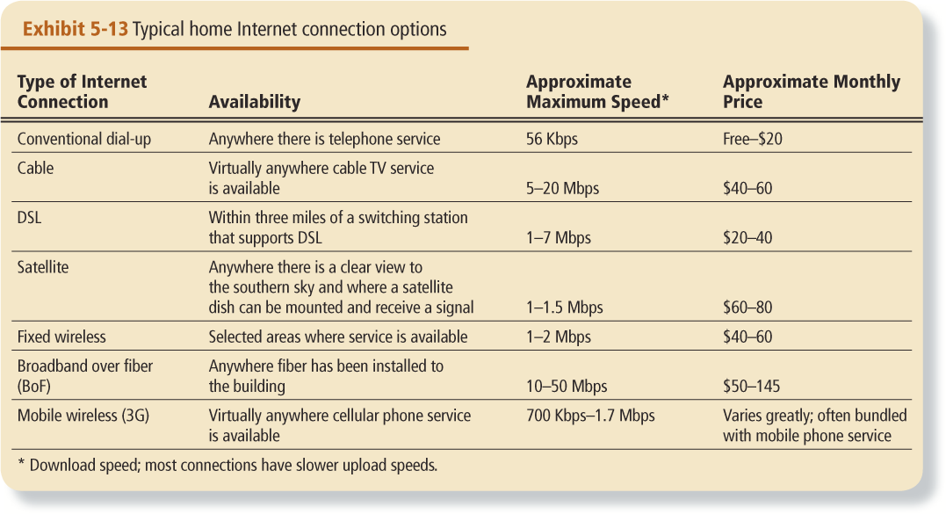
Choosing the Type of Connection and Internet Access

Slide 25
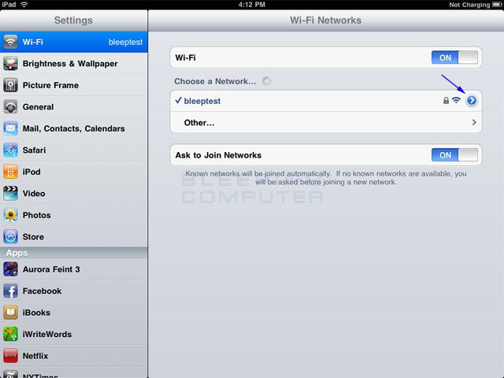
WiFi
A Wi-Fi hotspot is a location with a direct Internet connection and a wireless access point that allows users to connect wirelessly (via Wi-Fi) to the hotspot to use its Internet connection.

Slide 26
Selecting an ISP
The type of device used, the type of Internet connection and service desired, and your geographical location will likely determine your ISP options. Things to consider’;
Services
Speed
Support
Cost

Slide 27
Setting Up Your Computer
The specific steps for setting up your computer to use your selected type of Internet connection depend on
the type of device
the type of connection
the ISP you have chosen to use.

Slide 28
E-mail
The transmission of messages and files via a computer network
Messages can consist of simple text or can contain attachments, such as documents, graphics, or audio/video clips
Internet access providers usually provide an e-mail program
Some Web sites—such as MSN Hotmail and Yahoo!—provide free e-mail services

Slide 29
E-mail
The e-mail address is a combination of
domain
name
user name
samjohnson@scsite.com

Slide 30
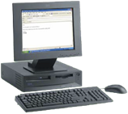

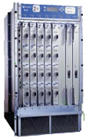
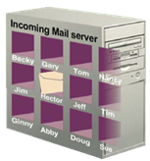
E-mail
How an e-mail message travels
outgoing mail server
incoming mail server
Internet
routers
POP 3
server

Slide 31
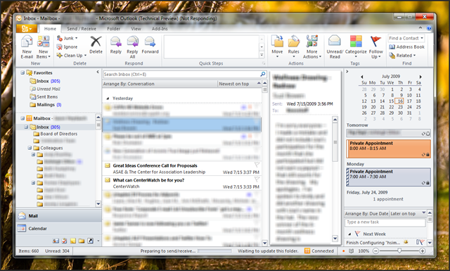
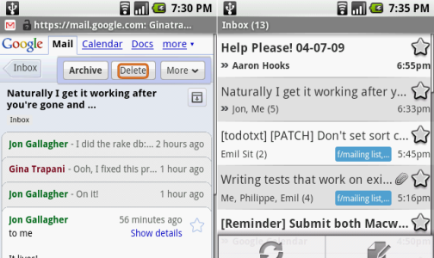
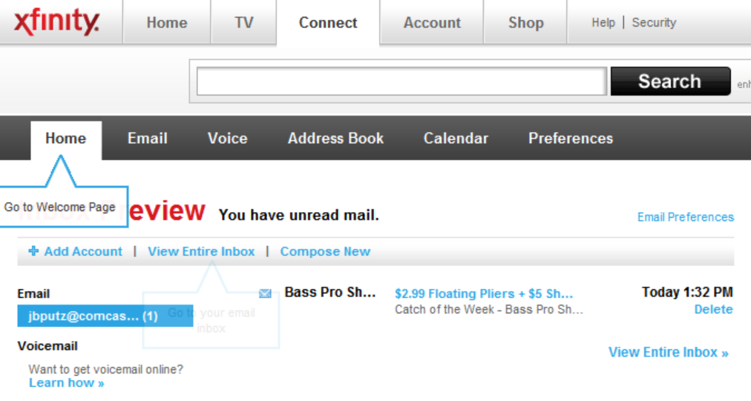
Accessing E-mail
E-mail clients are programs that allow you to send and receive e-mails.
Different ways to display your email
As part of a web site
App on a smart phone
Stand alone application.

Slide 32
World Wide Web
The World Wide Web, or simply Web, consists of a worldwide collection of electronic documents, Web pages, organized into Web sites
It is made up of three main parts.
Backbone
Internet
Cloud
Client
Server

Slide 33
World Wide Web - Addressing
The Internet Protocol Address or IP Address
Known as the dotted quad xxx.xxx.xxx.xxx
Number that uniquely identifies each computer or device connected to Internet
Domain Name is the text version of IP Address
www.amazon.com = 207.171.166.252

Slide 34
World Wide Web - URL
The Universal Resource Locator (URL) - Unique address for a web page located on a specific web server

Slide 35

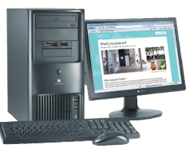

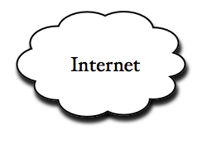
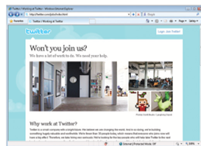
World Wide Web - URL
Twitter
server
Jobs
protocol
http://twitter.com/jobs/index.html
http://twitter.com/jobs

Slide 36
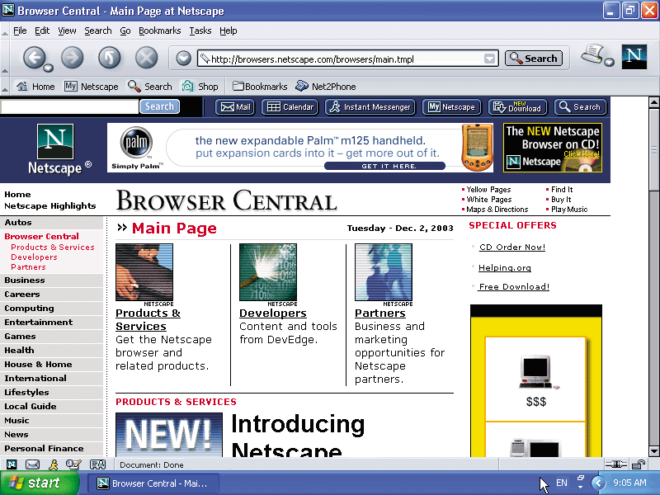
The Web Page
Web pages consist of three components;
Text
Multimedia
Graphics
Audio
Video
Hyperlinks

Slide 37
Hyperlinks
Text or graphics that connect (link) to other web pages.
Three types of links
Items found elsewhere on the same page
Different web pages in the same site.
Other web sites.
Hyperlinks can be text or graphics

Slide 38
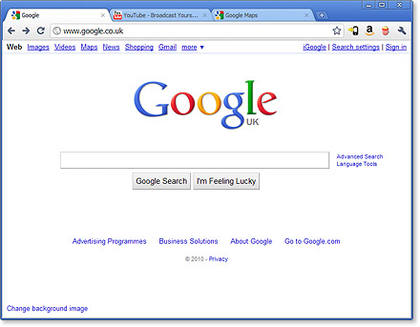
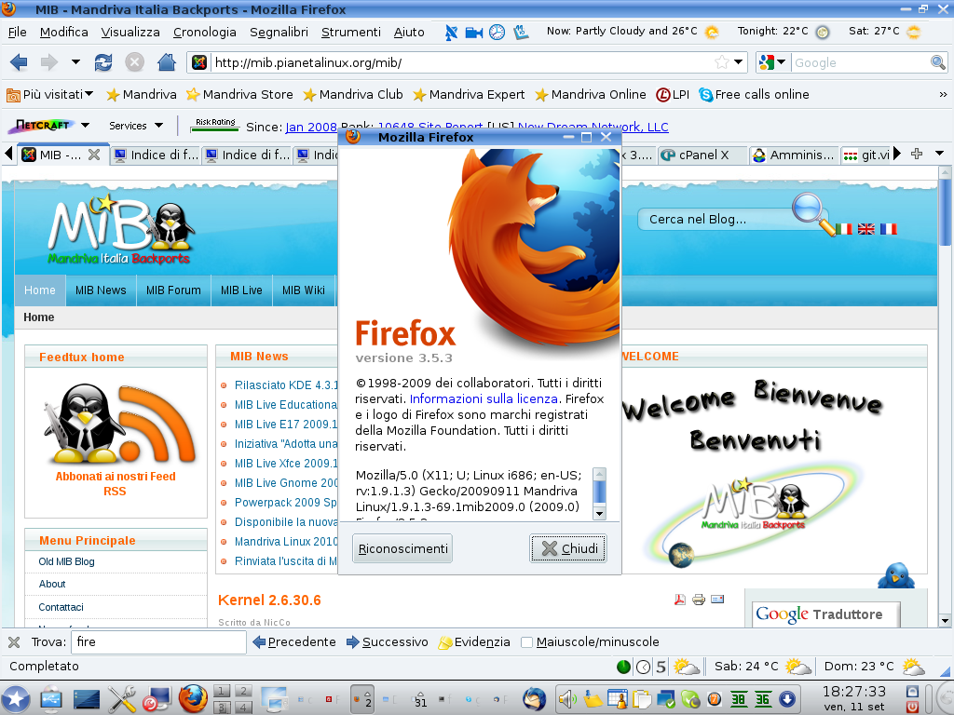
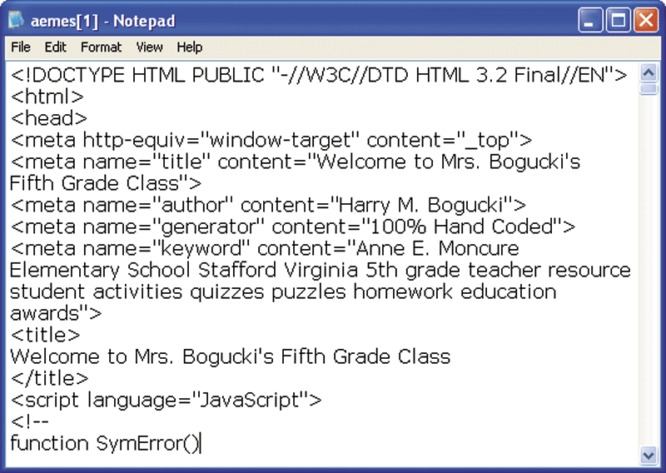
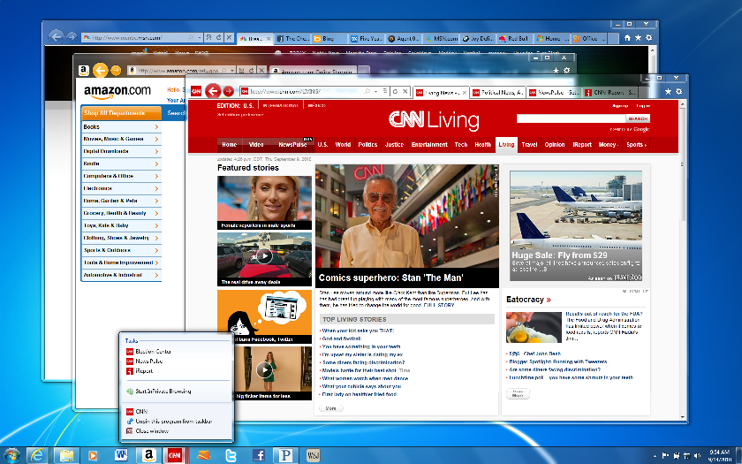
The Web Browser
Web Browser Software
Interprets HTML, displays Web pages and enables you to link to other Web pages and Web sites
The most popular browsers are;
Internet Explorer 9
FireFox
Google Chrome

Slide 39
The Web Browser
Web browser software have sub-systems that can help increase your efficiency when working on the internet, they include;
History
Bookmarks or favorites
Tabs

Slide 40
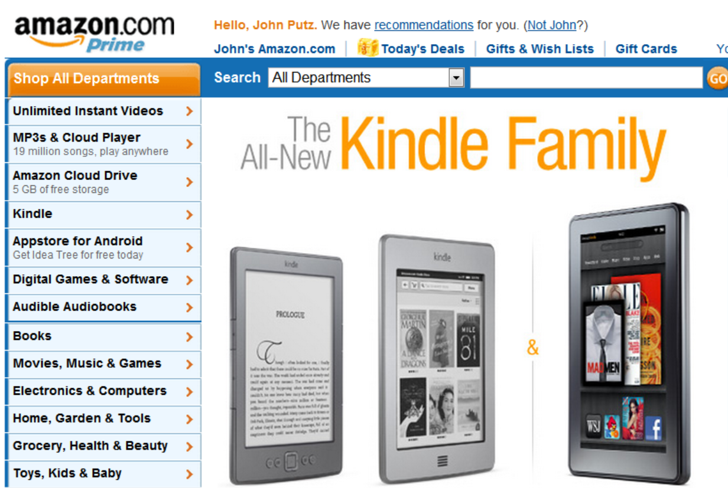
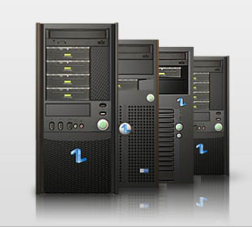
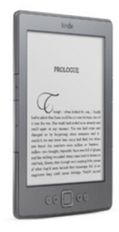
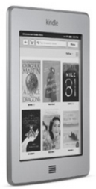

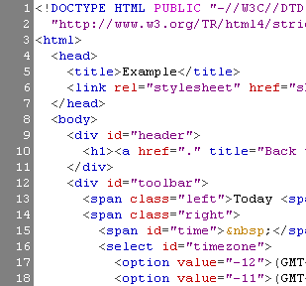
Downloading
The process of transferring information for a server to a client
www.amazon.com

Slide 41
Downloading
Downloading information can be effected by a number of variables;
Type of Internet connection
ISP
Time of day and day of week
Amount of information to be downloaded.

Slide 42
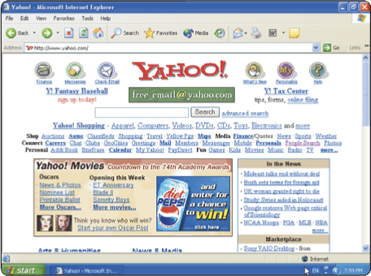
Categories of Web Sites - Portal
A Web site that offers a variety of services from one, convenient location, usually for free

Slide 43
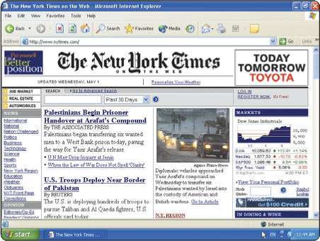
Categories of Web Sites - News
Contains newsworthy material
Stories and articles relating to current events, life, money, sports, and weather
News Archives

Slide 44
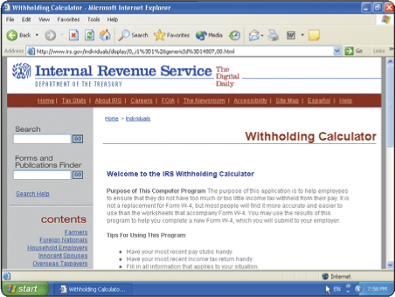
Categories of Web Sites - Informational
Contains factual information
Created by organizations and government agencies
Make sure that the web site is legitimate

Slide 45
Categories of Web Sites - Advocacy
Contains content that describes a cause, opinion, or idea

Slide 46
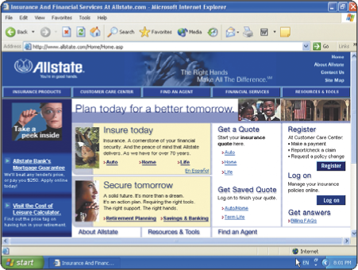
Categories of Web Sites – Business and Marketing
Contains content that promotes products
Allows you to purchase products or services online
Allows companies to purchase goods and service from other companies

Slide 47
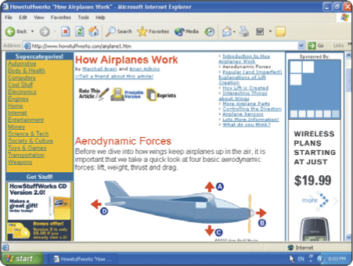
Categories of Web Sites – Education
Offers avenues for formal and informal teaching and learning
Colleges offer online classes and degrees
Some companies offer online training for employees

Slide 48
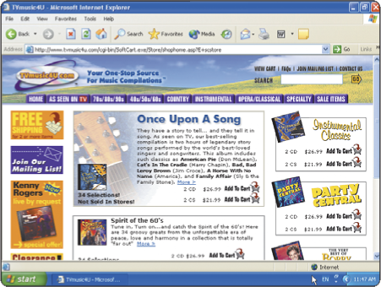
Categories of Web Sites – Entertainment
Offers an interactive environment featuring music, video, sports, games, and more

Slide 49
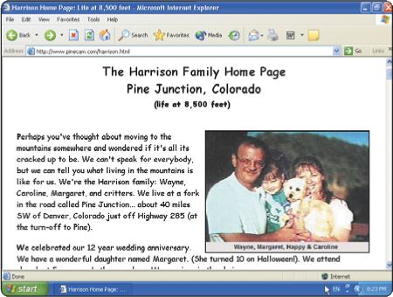
Categories of Web Sites – Personal
Web page maintained by private individual
Reasons: sharing life experience with the world or job hunting

Slide 50
Searching for Information on the Web
Search sites are used to find information on the World Wide Web. They include
Google
Yahoo
Bing
Two ways to search
Basic
Advanced

